Slide 1

LORDS INSTITUTE OF ENGINEERING AND TECHNOLOGY
Summer Internship Report
June – July 2022
Title: Online Dual Internship in AI and Data Analytics for Computer Science Engineering
Company Name: YBI Foundation
Presented By:
Name: Mohammed Tanveer Owais Internal Guide
Roll Number: 160919733109 Dr. Sunil Pappula
Course: B.E Year: 4th Semester: I Section: B

Slide 2
Outline
Title
Abstract
Objective
Methodology
Outcome
References
Picture of Certificate

Slide 3
Creating Virtual AI Paint Using AI.
Virtual AI Paint Using AI.

Slide 4
Abstract
Creating a Virtual Paint GUI which enables us to paint on the console by reading our finger movements through webcam.
We are using OpenCV, Mediapipe libraries in this project and implementing it in python language

Slide 5
Objective
The primary purpose of this project is making fun for small childrens by allowing them to paint on machine screen by moving their fingers.
The goal of this project is to obtain MS Paint functionality on machine console virtually.

Slide 6
Methodology
Our solution is based upon the libraries which is built by google itself “MediaPipe” and the AI Community i.e. “OpenCV”, let us recall that a general data analysis process is based on the following steps :
Data Acquisition:
(i)Obtaining the data from webcam
(ii)Visual investigation of the data space (webcam)
(iii)Collecting data from the image
Feature Extraction and Feature Analysis:
(i)Distance measurement between the fingers
(ii)Selecting the functionality by utilizing clear and paint options
(iii)If distance is less select otherwise continue with last opted function.

Slide 7
Methodology
If paint draw on console
If Erase, erase the selected painted area.
Results analysis:
(i) Accuracy of the model (depends upon quality of webcam)
(ii) Visualization of the grids.

Slide 8
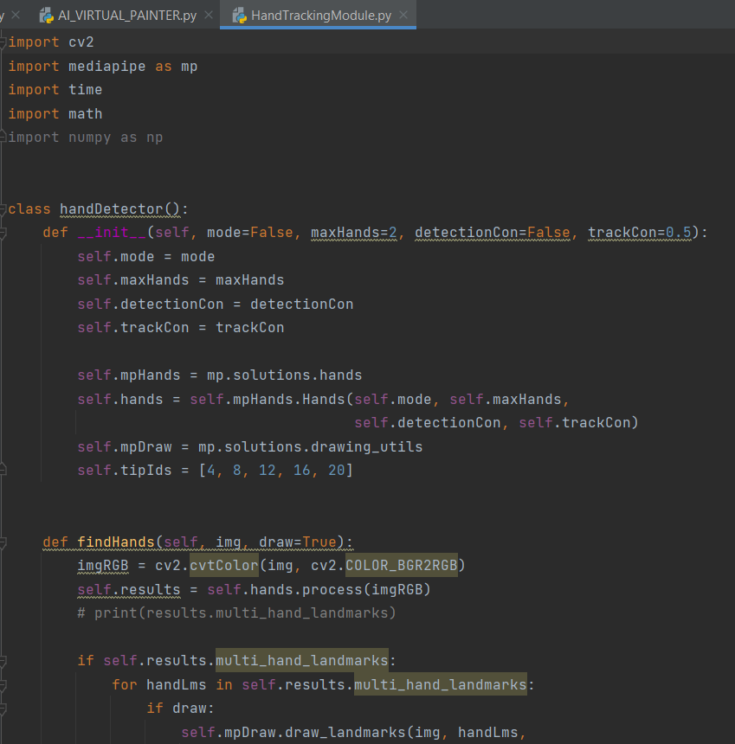
Code

Slide 9
Hand Tracking Module : 2
Hand Tracking Module : 3

Slide 10
AI Virtual Paint Code

Slide 11
AI VIRTUAL PAINT Code : 2

Slide 12
AI VIRTUAL PAINT Code : 3

Slide 13
OUTPUT
Hand Detection ( Tracks all 32 points of palm)

Slide 14
AI Virtual Paint Console(Home) Screen

Slide 15
PAINT MODE

Slide 16
ERASE MODE

Slide 17
Outcome
We can draw virtually on machine console by collecting data of finger movements from webcam and drawing on console successfully.

Slide 18
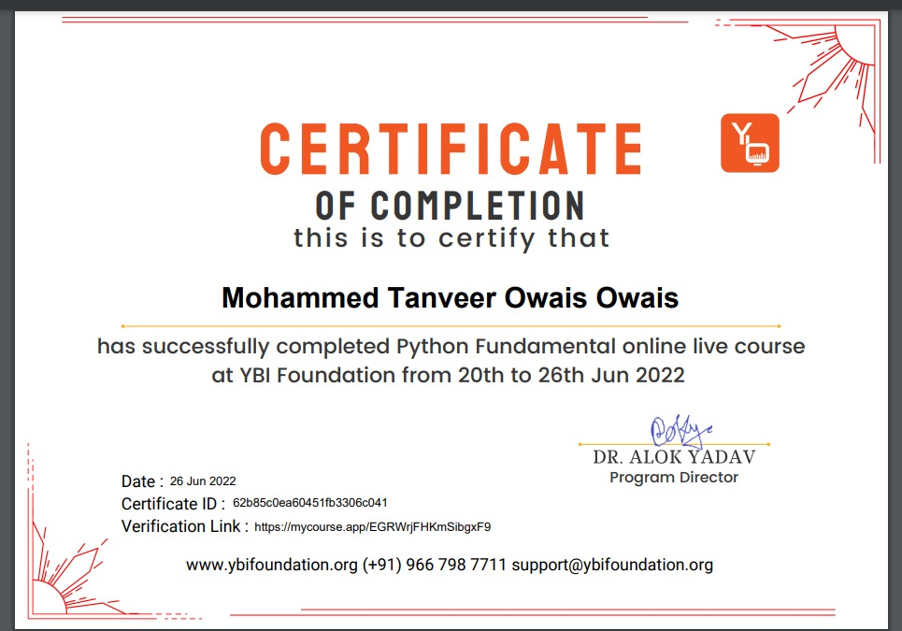
Picture of Certificate

Slide 19
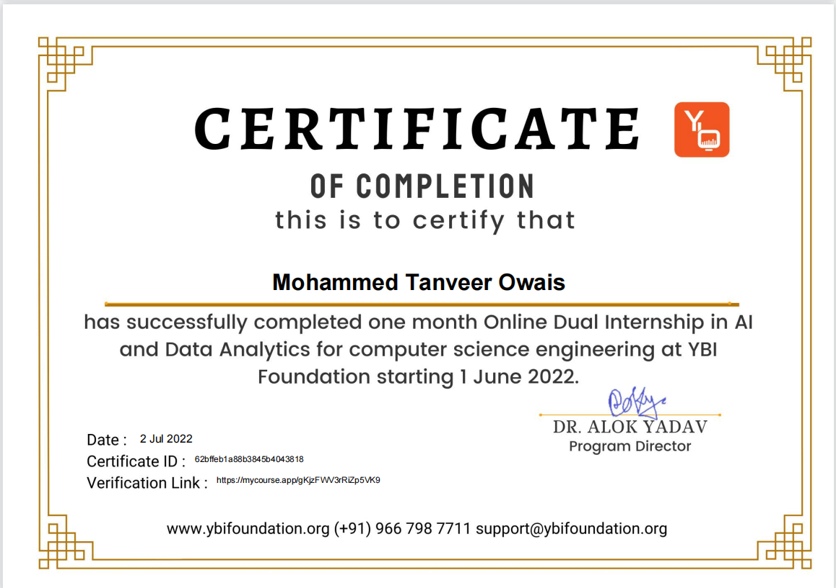

Slide 20
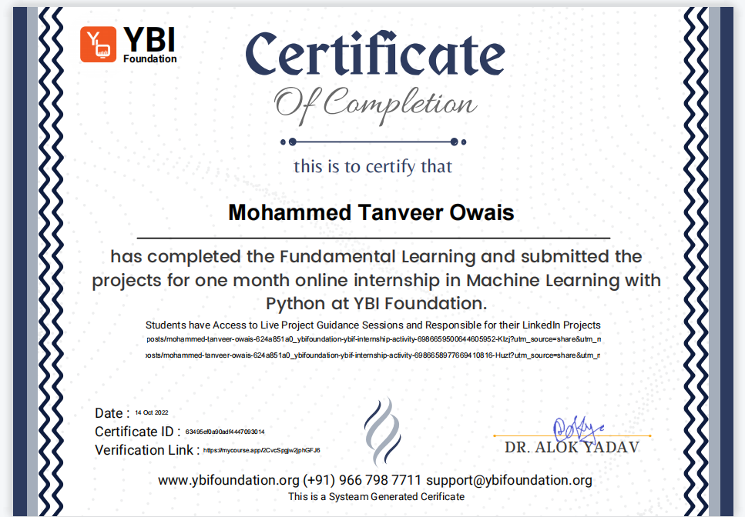

Slide 21
Thank You
Any Questions?

